Slide 1

Compiler Design Assignment 1
Iran University of Science & Technology
School of Computer Engineering
Spring 2021

Slide 2
Assignment Specifications
Subject: Install & use Antlr
Deadline: Saturday, 16 Esfand, 23:59 (Would not be extended!!)
Where to upload: LMS
Your report should be provided continuing these slides
Full Name: AmirHossein Ahmadi
Student ID: 97522292

Slide 3
Assignment Details
Install Antlr completely based on what was presented in the class & course slides. You have to install in both ways explained:
Manually with downloading JDK
Automatically in which IDE you want (PyCharm, VsCode, etc.)
Run ANTLR to generate lexical analyzer (Lexer) and parser for C++ language. (The CPP14 grammar file has attached in LMS)
Write a python program to accept a simple C++ program as input & generate parse tree for the program.
Explain all of the installation steps & your program completely in your report.

Slide 4
Assignment Details (Continued)
In addition to your report, you have to record a video (maximum of 10 minutes) of the Antler plugin installed in your IDE. Test some input strings as examples on the grammar & display the formed parsing tree. Also, explain the logic of the written code. Run your code to display the parsing tree.
Good Luck!

Slide 5
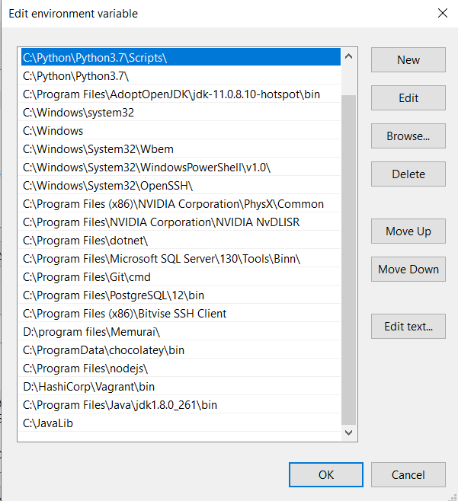
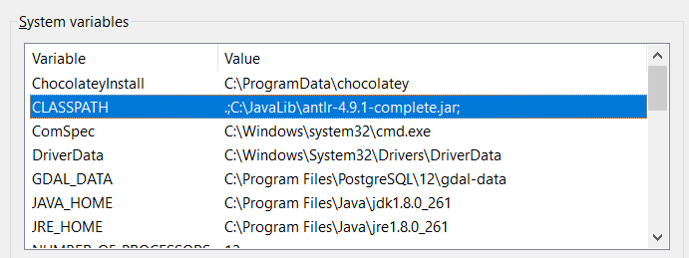
Install manually
Download https://www.antlr.org/download/antlr-4.9.1-complete.jar and save it in C:/JavaLib.
Add antlr4-complete.jar to CLASSPATH in Environment variables.
Add two following batch file in C:/JavaLib :
antlr4.bat → java org.antlr.v4.Tool %*
grun.bat → java org.antlr.v4.gui.TestRig %*

Slide 6
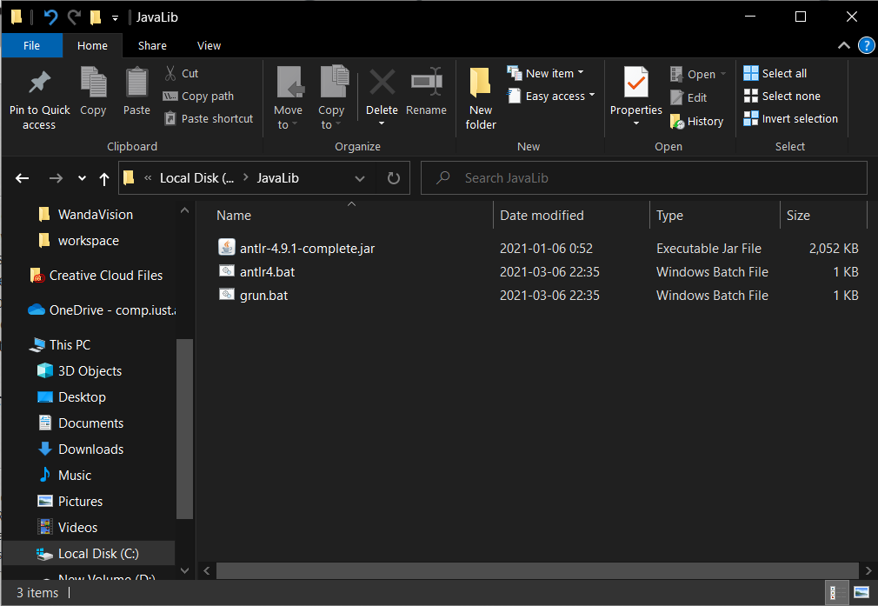
Install manually

Slide 7
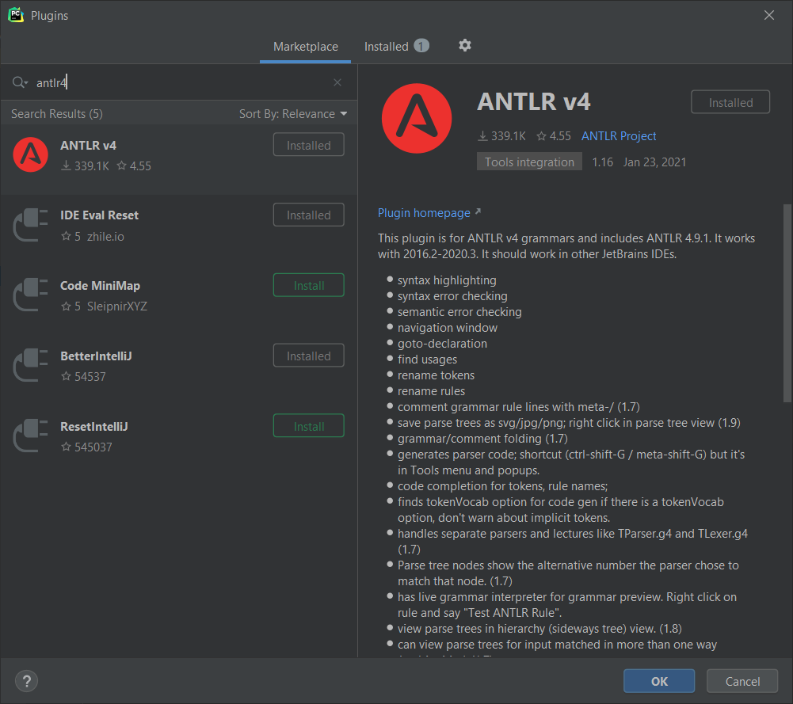
Install in Pycharm
- Open pycharm, go to Plugins and install antlr4 plugin

Slide 8
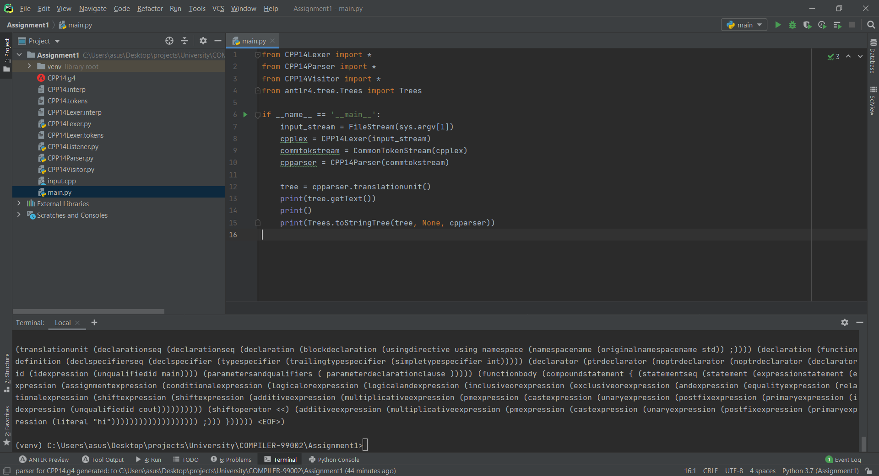
Write a python program to accept a simple C++ program as input & generate parse tree for the program.
Open grammer file and right click on the screen and click on “Configure ANTLR…”
Set Language Python3
Right click again and click “Generate ANTLR Recognizer”
Now write your python code.
Done.

